Slide 1
React Apps and API Integration 1
Frank Walsh

Slide 2
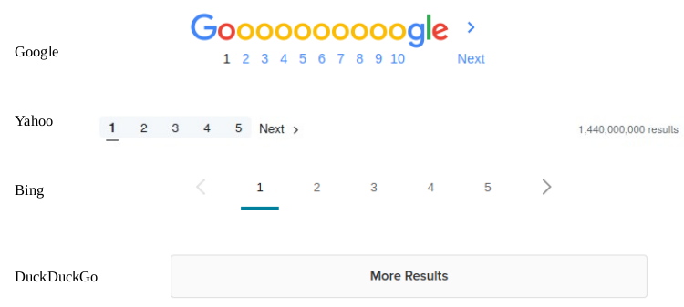
Asside: Server Side Pagination
Get Movies API:
GET /api/movies
Returns all Movies. Our DB is small but a real db will have thousands of movies
Need Pagination
Pagination means displaying a small number of results, by a page.
If there are only few pages, we can fetch all items and paginate on the client
For larger data sets, et the server do the work.
Server side pagination is better for:
Large data set
Faster initial page load
Accessibility for those not running JavaScript
Complex view business logic
This Photo by Unknown Author is licensed under CC BY-SA

Slide 3
Pagination: Movies API
router.get('/', asyncHandler(async (req, res) => {
let { page = 1, limit = 4 } = req.query; // destructure page and limit and set default values
[page, limit] = [+page, +limit]; //trick to convert to numeric (req.query will contain string values)
const totalDocumentsPromise = movieModel.estimatedDocumentCount(); //Kick off async calls
const moviesPromise = movieModel.find().limit(limit).skip((page - 1) * limit);
const totalDocuments = await totalDocumentsPromise; //wait for the above promises to be fulfilled
const movies = await moviesPromise;
const returnObject = { page: page, total_pages: Math.ceil(totalDocuments / limit), total_results: totalDocuments, results: movies };//construct return Object and insert into response object
res.status(200).json(returnObject);
}));

Slide 4
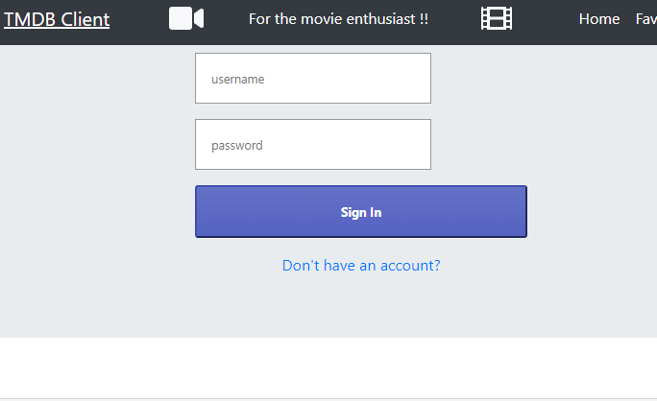
MovieDB React App
We want to:
Replace with calls to Movie API
Provide login/signin capabilities.
Only allow signed in users to see Movies and add stuff

Slide 5
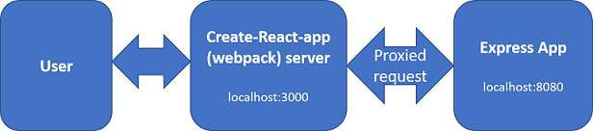
Proposed Architecture
Create-React-app uses Webpack development server.
Your Movie API is an Express.js app listening on port 8080 on your local host.
Configure Webpack server to "proxy" any unknown requests to Express app
Just need "proxy":"http://localhost:8080" entry in package.json of the React App.
Removes Cross-Origin-Resource-Sharing (CORS) issues with the browser

Slide 6
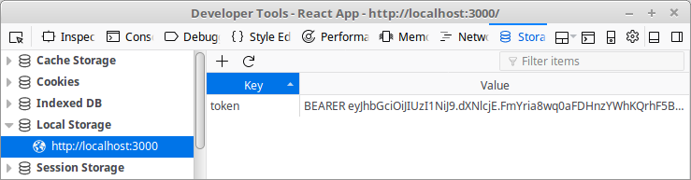
JavaWebToken Storage
Most browsers/devices have local storage .Can access using localStorage object.
localStorage.setItem('token', token);
const token = localStorage.getItem('token');

Slide 7
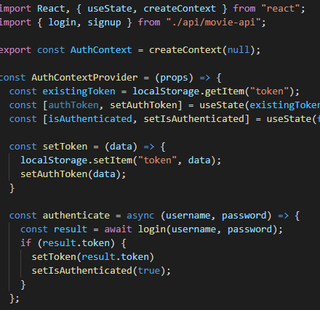
Contexts
Create a Authentication Context in MovieDB React App.
As with Movie context, use it to pass data through the component tree
Share authentication details between components

Slide 8
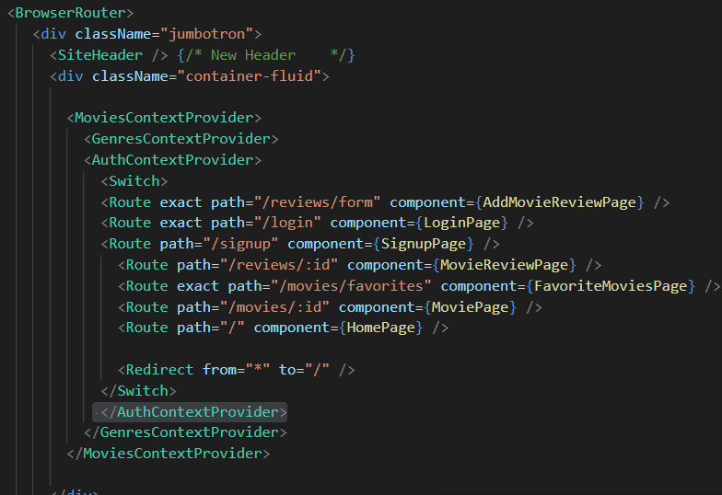
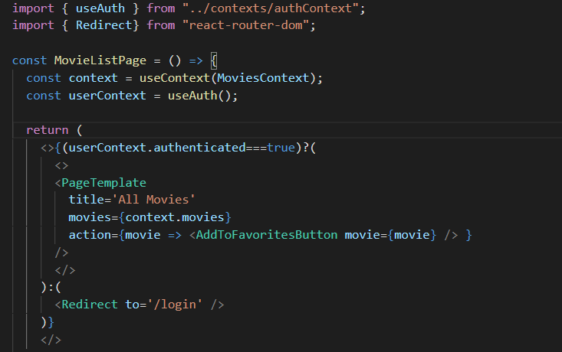
Use Context Provider in React App
Import context and use it to check authentication status

Slide 9
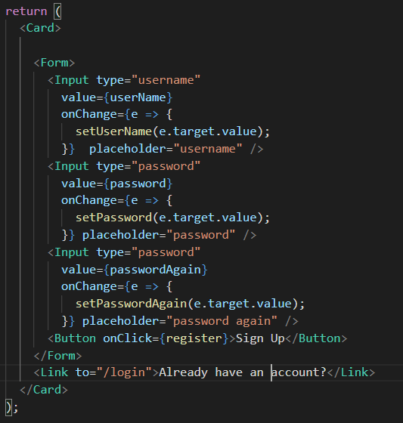
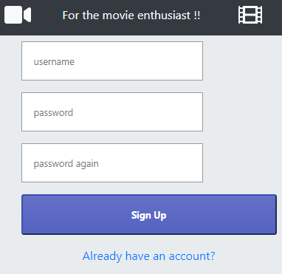

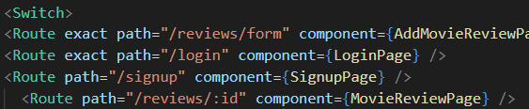
Login/Register Component
Add to App router (in index.js)

Slide 10
Integrating API into React App

Slide 11
Agenda
Review API Design
Develop front end API Module
Endpoint
Routes
React Authentication Context
React Login/Registration Page

Slide 12
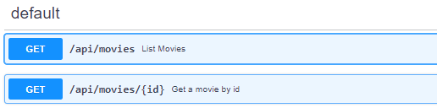
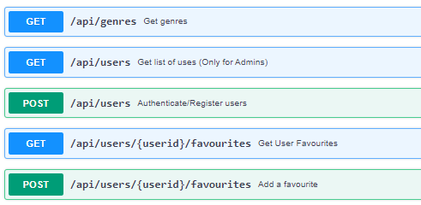
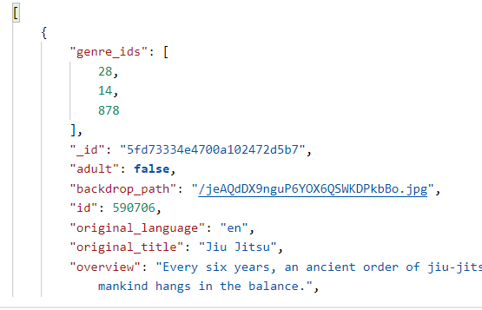
Review API Design
Fully understand the API
Examine Routes
Examine Request & Response Requirements
Body (e.g. properties)
Format (e.g. json)
Examine Authentication
JWT/Sessions
TEST WITH POSTMAN
Even better, write unit tests!

Slide 13
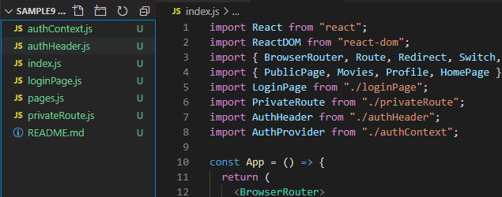
Design React App
This can be your Movies App from assignment 1
Use stub API/TMDB up to now
Can update to include authentication(login/register) pages and routes

Slide 14
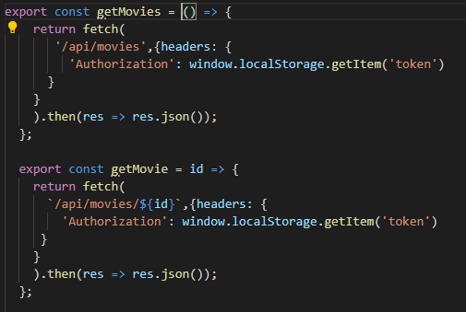
Write/Update API Module
Abstract API calls to exported functions.

Slide 15
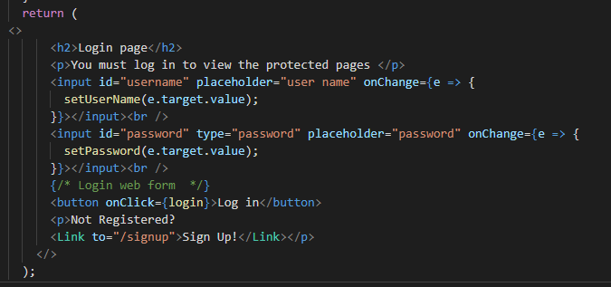
Update pages to use Contexts
Login Page:

